Slide 1

UNIVERSITY OF TORONTO DATA ANALYTICS BOOTCAMP
Final Project:
HOUSING PRICE PREDICTION IN TEXAS

Slide 2

EXECUTIVE SUMMARY
Overview:
Housing prices in Taxes-United States persistently rise alongside increasing incomes.
Objective: to forecast whether the housing market in Texas will experience an upward or downward trend in the next year.

Slide 3





Presentation Sections:
Data Exploration & Cleaning
Database
Machine Learning
Dashboard

Slide 4

TEAM MEMBER & ROLES
Bilal Ismail
Cleaning Data
Gurpal Gill
Data Base
Clarajean Lugenge
Tableau
Carson Moore
Tableau
Stephen Fernandes
Machine learning

Slide 5





TECHNOLOGY WE USED

Slide 6

Analysis Questions
Based on historical data, can we identify leading indicators that reliably predict changes in housing prices?
Is there a correlation between the average income in Texas to the average rent?
How does the population in each city correlate with average housing pricing in Texas?
What are the historical trends or patterns in housing prices in Texas from 2015 to 2023?
How stable is the housing market and are there indicators of potential instability?
Which city in Texas does the best in the features found from Machine Learning?

Slide 7

DATA EXPLORATION _ ETL
Extract data from multiple confirmed sources, ensuring it has all necessary information and limited null values
Transform data, removing null values and unnecessary columns, joining datasets, creating separate data frames, and creating look-up tables
Load the data by writing it into Postgres using the confirmed look-up tables to allow multiple users to access

Slide 8

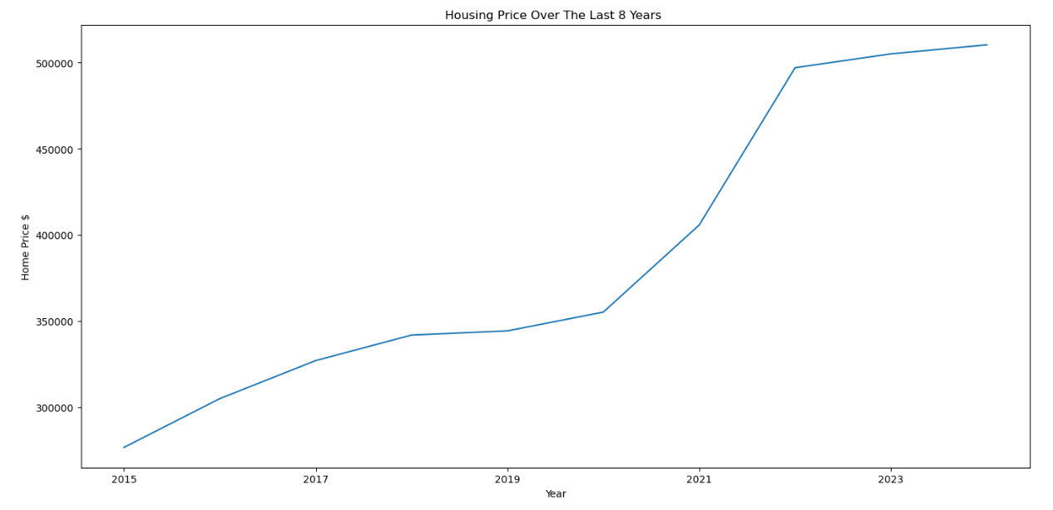
PRELIMINARY ANALYSIS
Looking at two zip code, 75001.0 and 75010.0, we found that housing prices have increased over the years
Preliminary Conclusion: Given the data for these two Zip code, it is possible housing markets may keep increasing within the next few years.

Slide 9

DATA AND SOURCES
Kaggle/Zillow - Zillow US House Price Data
Census - US City and Town Population Totals: 2015-2023
Kaggle/MoveHub - MoveHub City Rankings

Slide 10

DATABASE

Slide 11
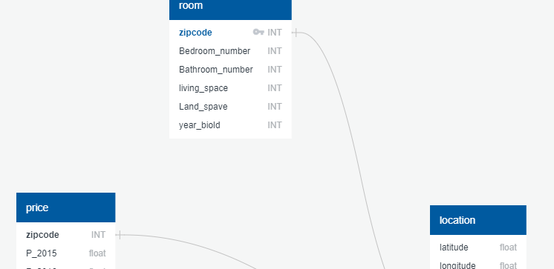


DATABASE PROCESS

Slide 12

MACHINE LEARNING

Slide 13


PRELIMINARY DATA PREPROCESSING
'zipcode', 'latitude', 'longitude', 'state', 'population', 'bedroom_number', 'bathroom_number', 'living_space', 'land_space', 'year_built', '2015', '2016', '2017', '2018', '2019', '2020', '2021', '2022', '2023', 'net_income', '2024'
Check data types for all columns in all housing prices dataset
Data set included zip code, population, average bedroom number, average bathroom numbers, average living space, average land space, average year build, prices with the steps of month from 2015 to 2023.

Slide 14

PRELIMINARY FEATURE ENGINEERING & SELECTION
We have identified several features that could potentially be relevant for a machine learning prediction task related to real estate or property-related analysis.
Each of these features provides different types of information that can be useful for making predictions or gaining insights.

Slide 15

Features
Zip Codes for cities in Texas
Population for each Zip Code
Average Income
Average Bedroom Number
Average Bathroom Number
Average Living Space
Average Land Space
Average Year Built
Average Prices from 2015 to 2023

Slide 16

MODEL
We've listed a variety of machine learning models for our prediction task. Each of these models has its own strengths and weaknesses, and their suitability depends on the nature of our data and the specific goals of your prediction:
Basic Linear Regression
Logistic Regression
Random Forest Optimized
Random Forest Train
Neural Network

Slide 17

MODEL CHOICE

Slide 18
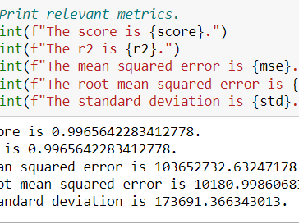

LINEAR REGRESSION
We decided to work with a linear regression model due to its achieved accuracy of 90%.

Slide 19

CONCLUSION FOR LINEAR REGRESSION
The model's performance metrics indicate an exceptionally high level of accuracy and precision.
With an R2 score and a correlation coefficient both equal to 0.9966, the model demonstrates a strong ability to explain the variance in the data.
The mean squared error of 103652732.63 and the root mean squared error of 10180.9986 suggest that the model's predictions are very close to the actual values, with minimal deviation.
Additionally, the standard deviation of 173691.3663 highlights the consistency of the model's predictions.
Overall, these metrics collectively affirm the reliability and effectiveness of the model in capturing the underlying patterns within the data.

Slide 20

DASHBOARDS

Slide 21

DASHBOARD ELEMENTS
Interactive elements:
The Zip code will be selected from a drop-down menu.
Shows the relation between income, population and housing price.
Other elements:
The remaining elements in the dashboard are static but are designed to effectively showcase various skills we have learned throughout the course.
The graphs reflect information from our dataset and allow the user to get a good overview about the zip code they are looking at. This information is helpful for anyone looking to move to Taxes.

Slide 22
INTERACTIVE DASHBOARD
For the dashboard segment of this project, we will be using Tableau Public. Click here to view our interactive dashboard embed, here to view our second interactive dashboard and here to view our final interactive dashboard.
All dashboards help to deeper analyze the data.

Slide 23

CONCLUSION

Slide 24

Analysis Results
Based on historical data, we can identify that the leading indicators that reliably predict changes in housing prices to be the average income and the average population quantity of a city in the state of Texas.
Analyzing the data and using linear regression models and plotting well informed graphs, we can identity a positive correlation between the average income in Texas to the average housing prices and the average population in each city to the average housing pricing in Texas.
Furthermore, it can be concluded that the housing market is stable seeing that the historical trend doesn’t involve any major highs and lows in the market.

Slide 25

Recommendation for Future Analysis
Explore more data sources to find more factors that could influence housing prices
Compare models against each other with their RMSE with naive forecasting
Use more features for machine learning such as Transpirations status, weather, education level, basement status, back yard status, neighborhood safety, market status, ect

Slide 26

Finally
Certainly! It's great to hear that all members of group 3 appreciate the attention to this project and are open to questions. Your positive feedback is appreciated!

Slide 27

The end

